Slide 1
Statistical Analysis of Rental Prices in Milan
Group 23
Shuhan Jiang
Hu Jiao
A. Ismail Oulkhir
Mathilde Sarah Vigouroux
Jingzhou Yang
Applied Statistics
Piercesare Secchi
2025-2026

Slide 2

Introduction : The Milanese Student Housing Crisis: A 191,000 Bed Deficit
2023 Tent Protests : A nation-wide outcry against +10.1% rent hikes.
Reality : 207,000 students vs. only 16,000 dedicated beds.
Low wages + Inflation + Short-term rental (AirBnb) squeeze = A market Perfect Storm where students are priced out of their own education.
Public Policy : Milano Cortina Olympic Village 2026 adds 1,700 beds - meeting only 6% of current unmet demand.
Politecnico Di Milano 2023. Reuters.

Slide 3
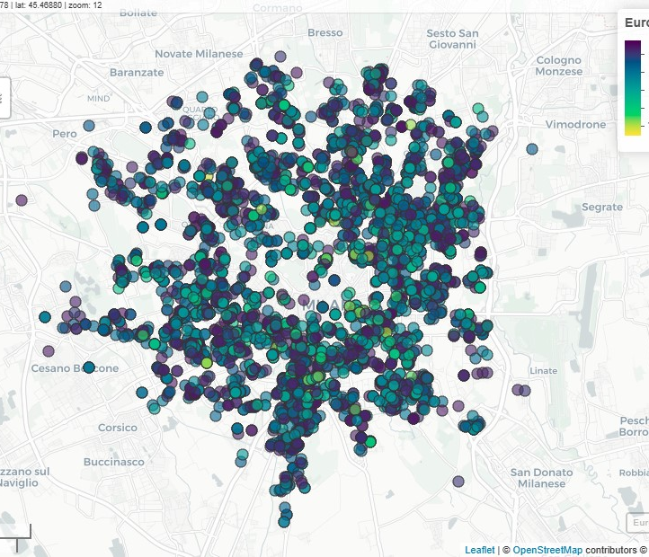
Data Extraction
Extracted Features : "price” - “N_rooms - “N_bathrooms” - "surface” - "floor“ - "heating” - "features” -"address“ - "macrozone" - "microzone" - "price_sqm”.
5363 data instances.
One hot encoding of categorical featureslike Presence of heating – balcony ….
Data extracted from Immobiliare. 2026.

Slide 4
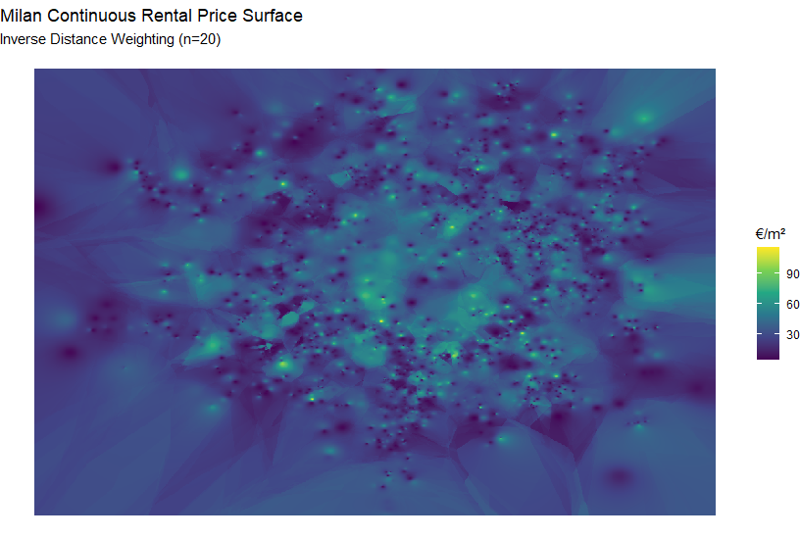
Exploratory Spatial Data Analysis
Price heatmap , concentration of expensive housing near Geographical Attractors,

Slide 5
Project Question
Quantifying the Student Premium: A Geospatial Analysis of Spatial and Structural Price Distortions in the Milanese Rental Market

Slide 6
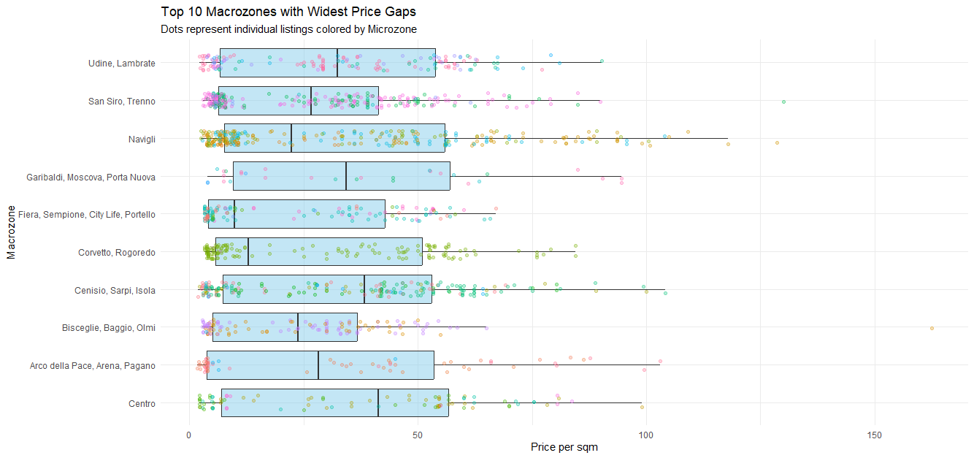
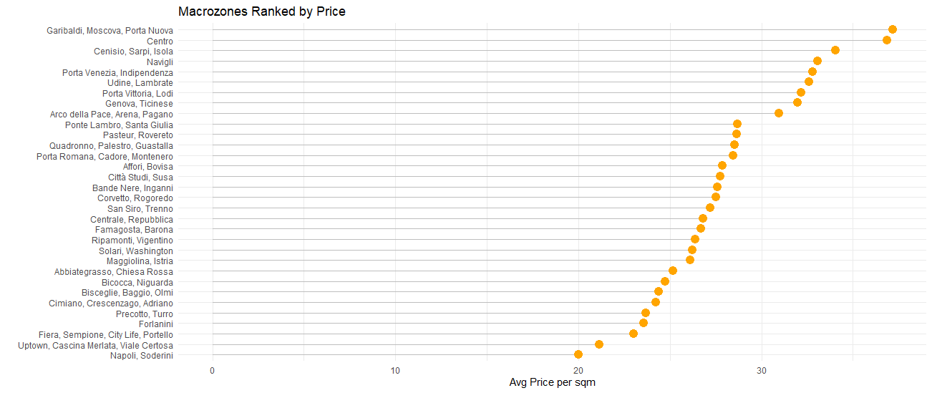
Discrepancies in prices between Macrozones of Milan
A guide on how to better choose your room ?

Slide 7
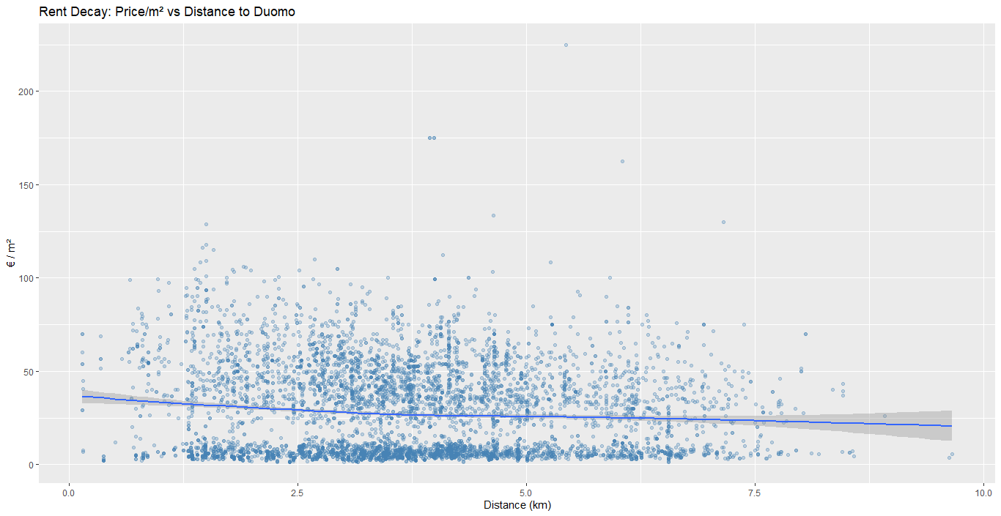
Geographical Attractors & Rent Decay
Bid-Rent Theory : CBD
Student Bubble (University Proximity)
Accessibility as price buffer
Rent Price Decay as distance increases farther from Duomo.

Slide 8
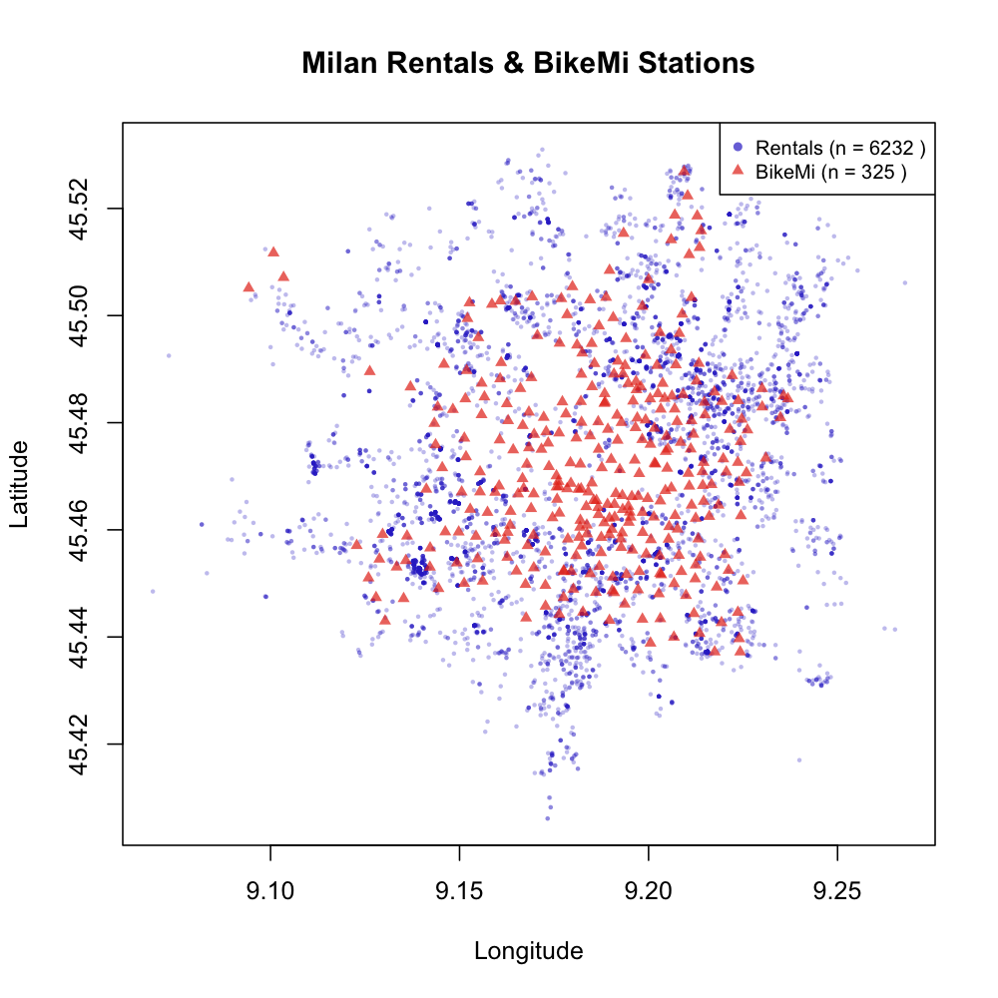

Enrichment : Facilities – Open DATA
Modelling Approach needs to take into account Spatial Data complementary to decision making process in housing process.
Metro Stations
Walkability (Network distances instead of Euclidian)
proximity to work
School quality
safety (crime rates)
access to amenities

Slide 9

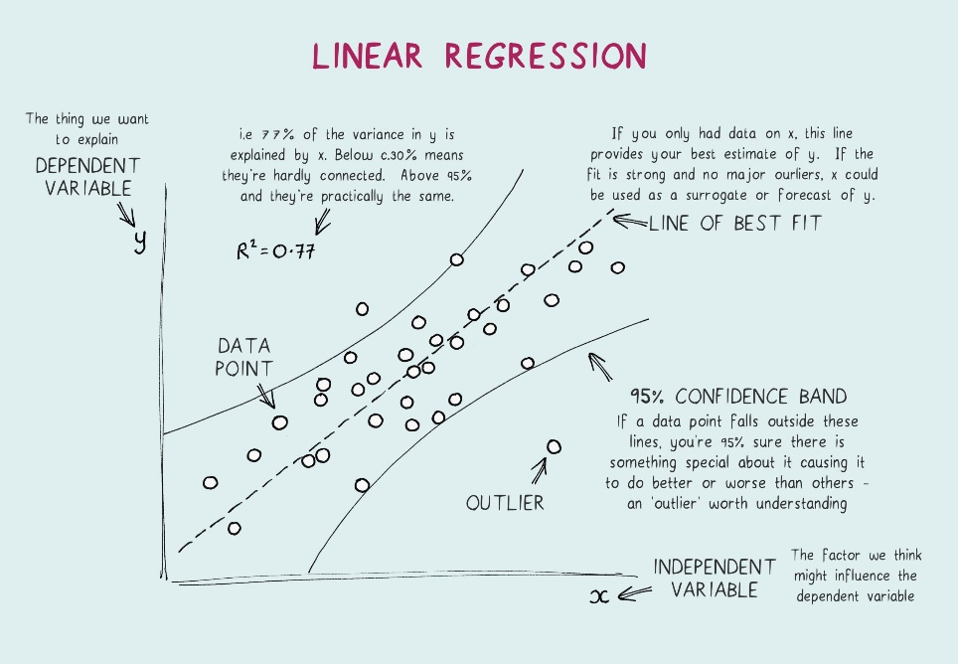
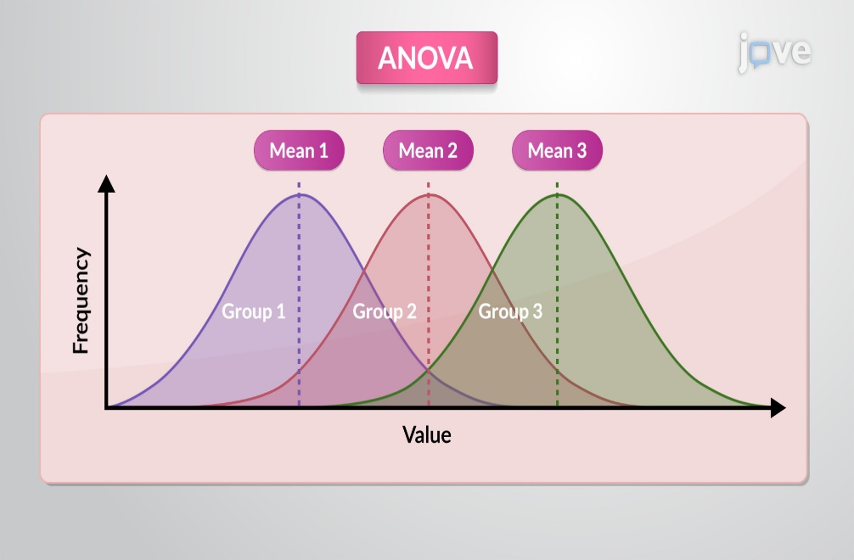
Statistical Techniques

Slide 10
What Does Success look like for our project ?
Room-Finding Guide
Goal : data-driven compass to navigate Milan’s rental market.
Outcome: Systematics Identification of trade-offs
The Urban Planning Heatmap
Goal: Mapping transit infrastructure and housing cost to guide future development.
Outcome: strategic locations for future student residences.

Slide 11
Thank you for you attention and see you soon !

